Slide 1
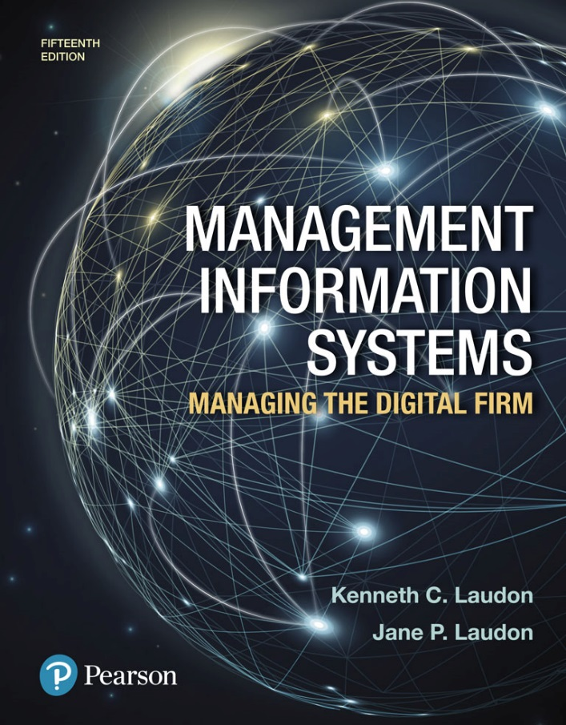
Management Information Systems: Managing the Digital Firm
Fifteenth edition
Chapter 13
Building Information Systems

Slide 2
Systems Development and Organizational Change (1 of 2)
IT-enabled organizational change
Automation
  Increases efficiency
  Replaces manual tasks
Rationalization of procedures
  Streamlines standard operating procedures
  Often found in programs for making continuous quality improvements
    Total quality management (TQM)
    Six sigma

Slide 3
Systems Development and Organizational Change (2 of 2)
Business process redesign
  Analyze, simplify, and redesign business processes
  Reorganize workflow, combine steps, eliminate repetition
Paradigm shifts
  Rethink nature of business
  Define new business model
  Change nature of organization

Slide 4
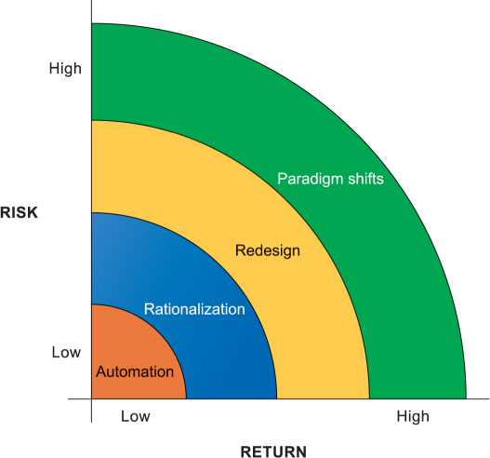
Figure 13.1: Organizational Change Carries Risks and Rewards

Slide 5
Business Process Redesign
Business process management (BPM)
  Variety of tools, methodologies to analyze, design, optimize processes
  Used by firms to manage business process redesign
Steps in BPM
  Identify processes for change
  Analyze existing processes
  Design the new process
  Implement the new process
  Continuous measurement

Slide 6
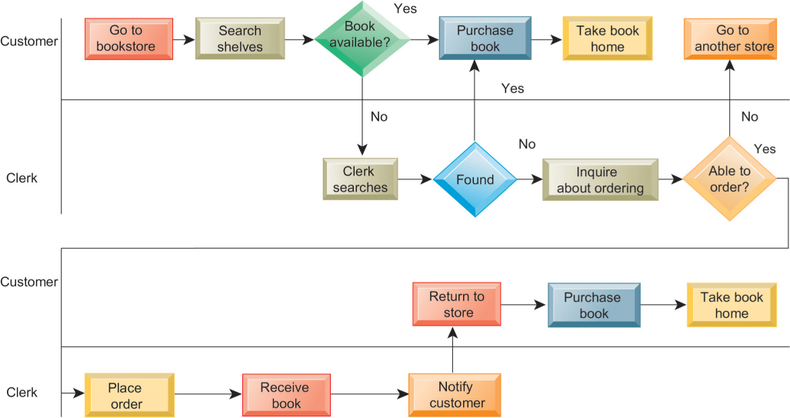
Figure 13.2: As-is Business Process for Purchasing a Book from a Physical Bookstore

Slide 7
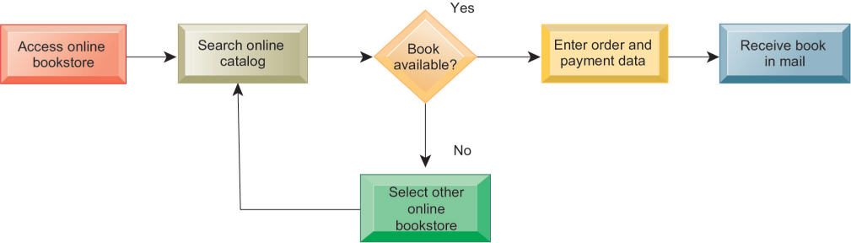
Figure 13.3: Redesigned Process for Purchasing a Book Online

Slide 8
Tools for Business Process Management
Identify and document existing processes
  Identify inefficiencies
Create models of improved processes
Capture and enforce business rules for performing, automating processes
Integrate existing systems to support process improvements
Verify that new processes have improved
Measure impact of process changes on key business performance indicators

Slide 9
Systems Development
Activities that go into producing an information system solution to an organizational problem or opportunity
  Systems analysis
  Systems design
  Programming
  Testing
  Conversion
  Production and maintenance

Slide 10
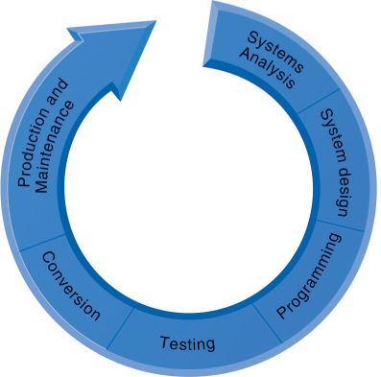
Figure 13.4: The Systems Development Process

Slide 11
Systems Analysis
Analysis of problem to be solved by new system
  Defining the problem
  Identifying causes
  Specifying solutions
  Identifying information requirements
Feasibility study
Systems proposal report
Information requirements
  Faulty requirements analysis is a leading cause of systems failure and high systems development costs

Slide 12
Systems Design
Describes system specifications that will deliver functions identified during systems analysis
Should address all managerial, organizational, and technological components of system solution
Role of end users
  User information requirements drive system building
  Users must have sufficient control over design process to ensure system reflects their business priorities and information needs
  Insufficient user involvement in design effort is major cause of system failure

Slide 13
Table 13.1 System Design Specifications (1 of 2)
Category | Specifications
Output | Medium, Content, Timing
Input | Origins, Flow, Data entry
User Interface | Simplicity, Efficiency, Logic, Feedback, Errors
Database Design | Logical data model, Volume and speed requirements, File organization and design, Record specifications
Processing | Computations, Program modules, Required reports, Timing of outputs
Manual Procedures | What activities, Who performs them, When, How, Where
Controls | Input controls (characters, limit, reasonableness), Processing controls (consistency, record counts), Output controls (totals, samples of output), Procedural controls (passwords, special forms)

Slide 14
Table 13.1 System Design Specifications (2 of 2)
Category | Specifications
Security | Access controls, Catastrophe plans, Audit trails
Documentation | Operations documentation, Systems documents, User documentation
Conversion | Transfer files, Initiate new procedures, Select testing method Cut over to new system
Training | Select training techniques, Develop training modules, Identify training facilities
Organizational Changes | Task redesign, Job redesign, Process design, Organization structure design, Reporting relationships

Slide 15
Completing the Systems Development Process (1 of 3)
Programming
  System specifications from design stage are translated into software program code
Testing
  Ensures system produces right results
  Unit testing: Tests each program in system separately
  System testing: Test functioning of system as a whole
  Acceptance testing: Makes sure system is ready to be used in production setting
  Test plan: All preparations for series of tests

Slide 16
Completing the Systems Development Process (2 of 3)
Conversion
  Process of changing from old system to new system
  Four main strategies
    Parallel strategy
    Direct cutover
    Pilot study
    Phased approach
  Requires end-user training
  Finalization of detailed documentation showing how system works from technical and end-user standpoint

Slide 17
Completing the Systems Development Process (3 of 3)
Production and maintenance
  System reviewed to determine if revisions needed
  May include post-implementation audit document
  Maintenance
    Changes in hardware, software, documentation, or procedures to a production system to correct errors, meet new requirements, or improve processing efficiency
      20 percent debugging, emergency work
      20 percent changes to hardware, software, data, reporting
      60 percent of work: user enhancements, improving documentation, recoding for greater processing efficiency

Slide 18
Table 13.2 Systems Development
CORE ACTIVITY | CORE ACTIVITY
Systems analysis | Identify problem(s), Specify solutions, Establish information requirements
Systems design | Create design specifications
Programming | Translate design specifications into program code
Testing | Perform unit testing, Perform systems testing, Perform acceptance testing
Conversion | Plan conversion, Prepare documentation, Train users and technical staff
Production and maintenance | Operate the system, Evaluate the system, Modify the system

Slide 19
Structured Methodologies (1 of 2)
Structured: Techniques are step-by-step, progressive
Process-oriented: Focusing on modeling processes or actions that manipulate data
Separate data from processes
Data flow diagram (DFD)
  Represents system’s component processes and flow of data between them
  Logical graphic model of information flow

Slide 20
Structured Methodologies (2 of 2)
Data dictionary
  Defines contents of data flows and data stores
Process specifications
  Describe transformation occurring within lowest level of data flow diagrams
Structure chart
  Top-down chart, showing each level of design, relationship to other levels, and place in overall design structure

Slide 21
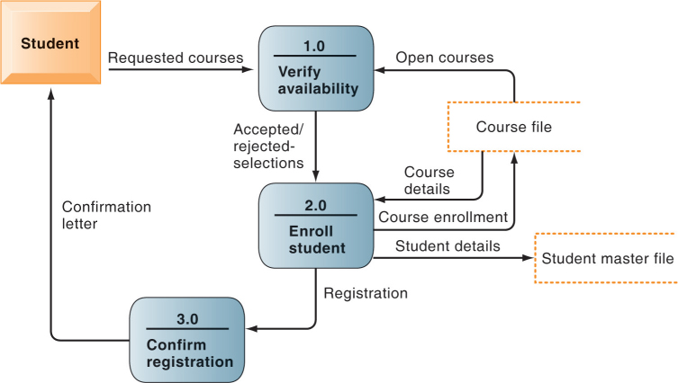
Figure 13.6: Data Flow Diagram for Mail-in University Registration System

Slide 22
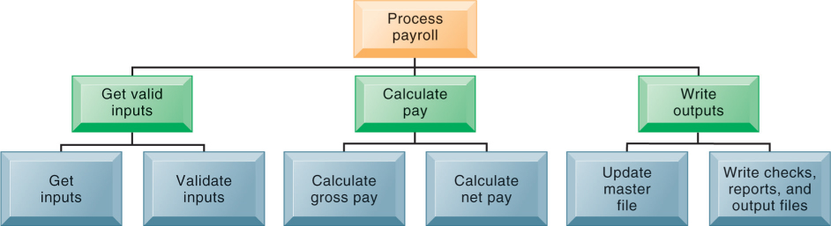
Figure 13.7: High-level Structure Chart for a Payroll System

Slide 23
Object-Oriented Development (1 of 2)
Object
  Basic unit of systems analysis and design
  Combines data and the processes that operate on those data
  Data in object can be accessed only by operations associated with that object
Object-oriented modeling
  Based on concepts of class and inheritance
  Objects belong to a certain class and have features of that class
  May inherit structures and behaviors of a more general, ancestor class

Slide 24
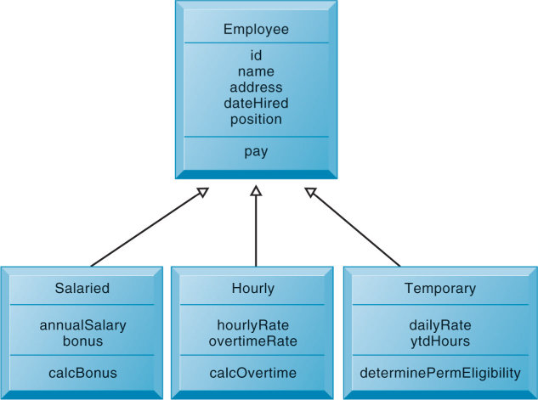
Figure 13.8: Class and Inheritance

Slide 25
Object-Oriented Development (2 of 2)
More iterative and incremental than traditional structured development
  Systems analysis: Interactions between system and users analyzed to identify objects
  Design phase: Describes how objects will behave and interact; grouped into classes, subclasses, and hierarchies
  Implementation: Some classes may be reused from existing library of classes, others created or inherited
Objects are reusable
  Object-oriented development can potentially reduce time and cost of development

Slide 26
Computer-Aided Software Engineering
Software tools to automate development and reduce repetitive work, including:
  Graphics facilities for producing charts and diagrams
  Screen and report generators, reporting facilities
  Analysis and checking tools
  Data dictionaries
  Code and documentation generators
Support iterative design by automating revisions and changes and providing prototyping facilities
Require organizational discipline to be used effectively

Slide 27
Traditional Systems Life Cycle
Oldest method for building information systems
Phased approach
  Development divided into formal stages
  “Waterfall” approach: One stage finishes before next stage begins
Formal division of labor between end users and information systems specialists
Emphasizes formal specifications and paperwork
Still used for building large complex systems
Can be costly, time-consuming, and inflexible

Slide 28
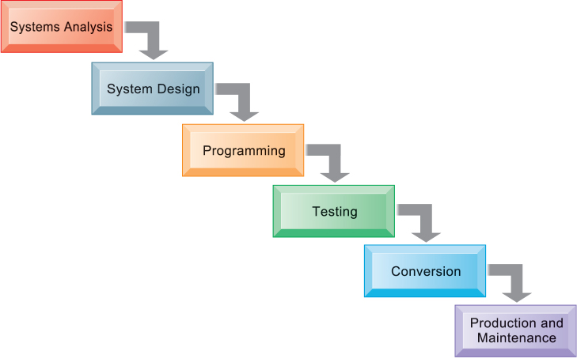
Figure 13.9: The Traditional Systems Development Life Cycle

Slide 29
Prototyping (1 of 2)
Building experimental system rapidly and inexpensively for end users to evaluate
Prototype: Working but preliminary version of information system
  Approved prototype serves as template for final system
Steps in prototyping
    Identify user requirements
    Develop initial prototype
    Use prototype
    Revise and enhance prototype

Slide 30
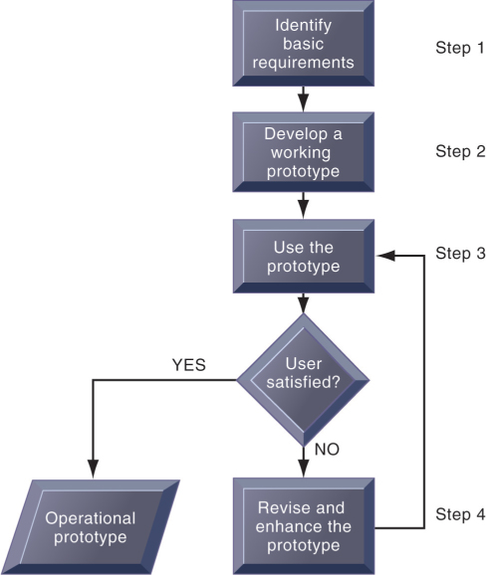
Figure 13.10: The Prototyping Process

Slide 31
Prototyping (2 of 2)
Advantages of prototyping
  Useful if some uncertainty in requirements or design solutions
  Often used for end-user interface design
  More likely to fulfill end-user requirements
Disadvantages
  May gloss over essential steps
  May not accommodate large quantities of data or large number of users
    May not undergo full testing or documentation

Slide 32
End-User Development (1 of 2)
Allows end users to develop simple information systems with little or no help from technical specialists
Reduces time and steps required to produce finished application
Tools include
  User friendly query languages and reporting
  PC software tools

Slide 33
End-User Development (2 of 2)
Advantages
  More rapid completion of projects
  High level of user involvement and satisfaction
Disadvantages
  Not designed for processing-intensive applications
  Inadequate management and control, testing, documentation
  Loss of control over data
Managing end-user development
  Require cost-justification of end-user system projects
  Establish hardware, software, and quality standards

Slide 34
Application Software Packages and Cloud Software Services
Application software packages and cloud software services
  Save time and money
  Many packages offer customization features
Evaluation criteria for systems analysis include:
  Functions provided, flexibility, user friendliness, required resources, database requirements, installation and maintenance efforts, documentation, vendor quality, and cost
Request for Proposal (RFP)
  Detailed list of questions submitted to packaged-software vendors
  Used to evaluate alternative software packages

Slide 35
Outsourcing (1 of 2)
Several types
  Cloud and SaaS providers
    Subscribing companies use software and computer hardware provided by vendors
  External vendors
    Hired to design, create software
    Domestic outsourcing
      Driven by firm’s need for additional skills, resources, assets
    Offshore outsourcing
      Driven by cost-savings

Slide 36
Outsourcing (2 of 2)
Advantages
  Allows organization flexibility in IT needs
Disadvantages
  Hidden costs, for example:
    Identifying and selecting vendor
    Transitioning to vendor
  Opening up proprietary business processes to third party

Slide 37
Rapid Application Development (RAD), Agile Development, and DevOps
Rapid application development (RAD)
  Process of creating workable systems in a very short period of time
Joint application design (JAD)
  Used to accelerate generation of information requirements and to develop initial systems design
Agile development
  Focuses on rapid delivery of working software by breaking large project into several small subprojects
DevOps
  Builds on Agile development principles as an organizational strategy

Slide 38
Component-Based Development and Web Services
Component-based development
  Groups of objects that provide software for common functions (e.g., online ordering) and can be combined to create large-scale business applications
Web services
  Reusable software components that use XML and open Internet standards (platform independent)
  Enable applications to communicate with no custom programming required to share data and services
  Can engage other web services for more complex transactions

Slide 39
Mobile Application Development
Mobile websites
Mobile web apps
Native apps
Special requirements for mobile platform
  Smaller screens, keyboards, multitouch gestures, saving resources (memory, processing)
Responsive web design
  Websites programmed so that layouts change automatically according to user’s computing device

Slide 40
End

